Slide 1



Demat account and online trading

Slide 2

What is demat ?
Conversion of physical securities into electronic form
No distinctive number to securities required as depositing and withdrawing money from a bank without bothering about distinctive number of currency.

Slide 3
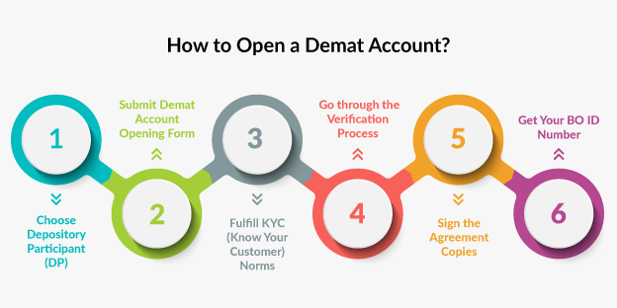
https://youtube.com/shorts/r0u9w31Jpm8?si=EnSIkaIECMiOmarE
https://youtube.com/shorts/r0u9w31Jpm8?si=EnSIkaIECMiOmarE

Slide 4

List of Sites to Open a Demat Account Online :
https://startuptalky.com/top-demat-account-opening-platforms/#Zerodha

Slide 5
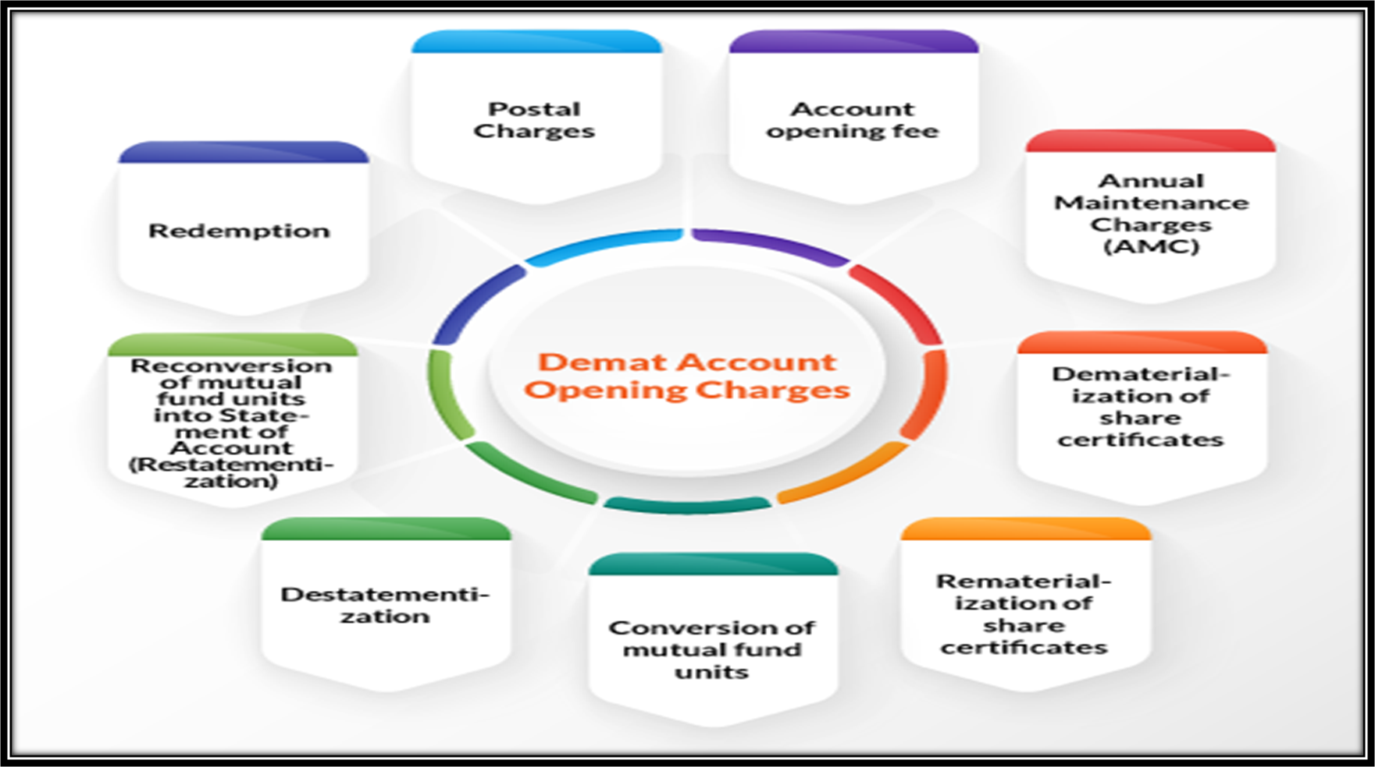

Slide 6
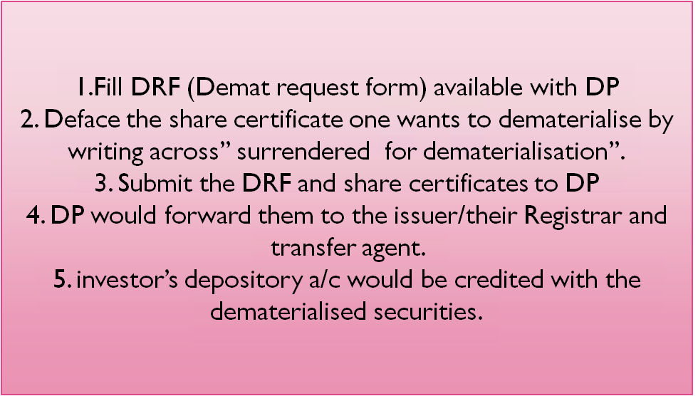
Procedure of demat account – for an investor

Slide 7

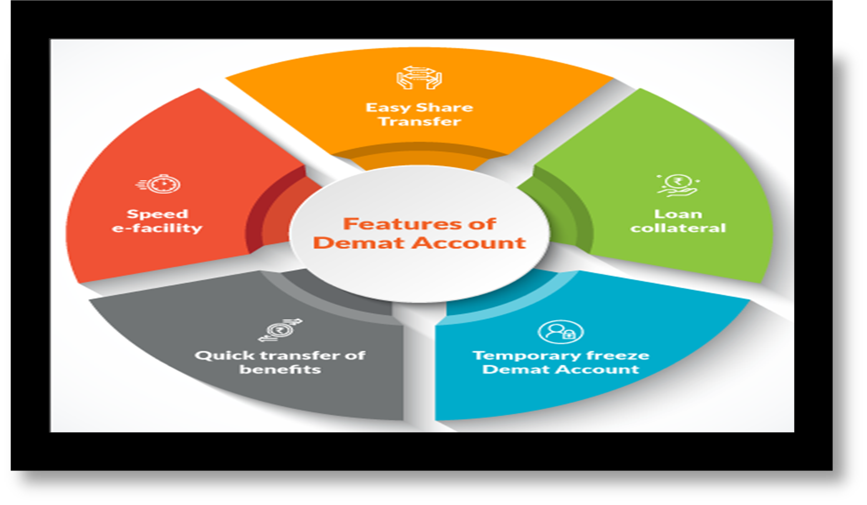
Features of Demat Accounting

Slide 8

Demat-need?
Bad deliveries due to signature difference
Mistakes in completion of transfer deeds
Tearing and mutilation of securities
Fake certificates
Fraudulent interception of certificate in transit
Transfer stamp duty
Extra consumption of time by the companies
Postal delays and charges etc

Slide 9

Demat- Participants
Investors
The depository
1.NSDL(national securities depository ltd.)
2.CSDIL(central depository of securities India ltd.)
The depository participants
The issuing company

Slide 10

National securities depository limited (nsdl)
Establish in august 1996 as the first depository in India.
This depository promoted by institutions of national stature responsible for economic development of the country has since established a national infrastructure of international standards that handles most of the securities held and settled in dematerialized form in the Indian capital market.
NSDL has around 1,23,84,644 investors associated with it currently and has 14,336 service centers all over India.

Slide 11

Central depository of service limited (cdsl)
CDSL received the certificate of commencement of business from SEBI in February,1999.
All leading stock exchange like the national stock exchange, Calcutta stock exchange, Delhi stock exchange, the stock exchange , Ahmedabad etc, have establish connectively with CDSL.
Currently around 81 lakh investors and 12000 companies have admitted their securities , units of mutual funds, certificate of deposits etc. into the CDSL system.
CDSL has around 568 depository participants (DPs) in around 13000 different locations all over India.

Slide 12
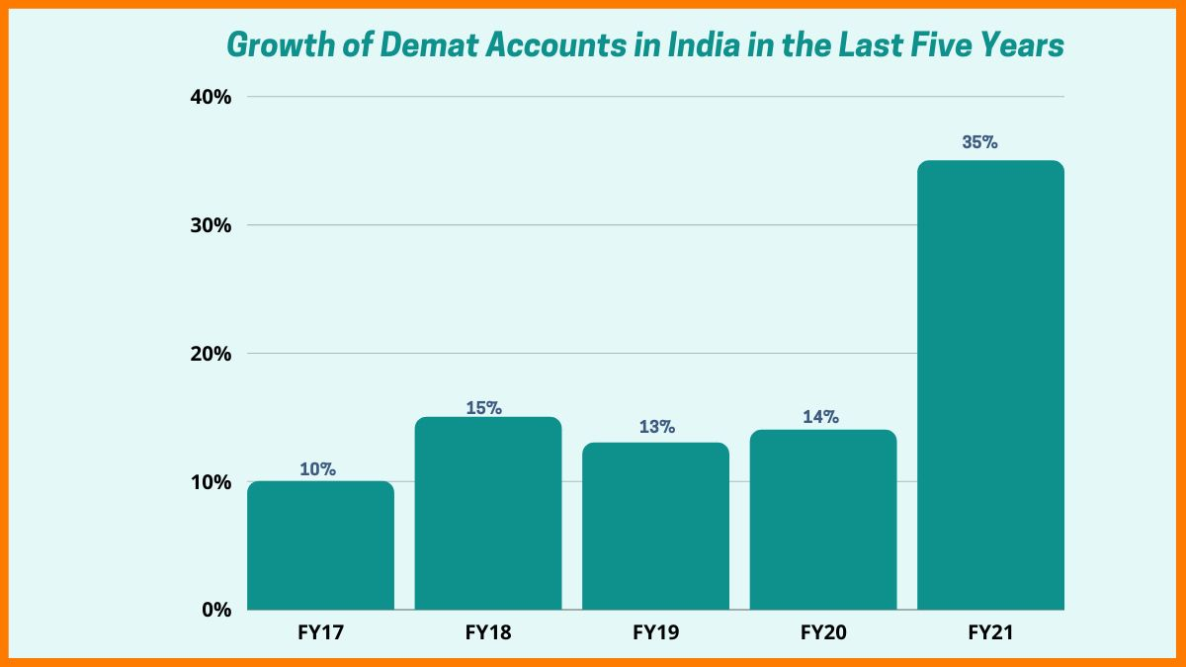

Slide 13

Other benefits :
Allotment directly in demat from possible
Pledge of demat holdings possible
Lending /borrowing of demat securities to/from an authorized intermediary
Freezing of A/C possible
Transmission of holdings
Nomination facility

Slide 14

Online trading :
• Online trading in securities refers to the facility of investor being able to place his own orders using the internet trading platform offered by the trading member viz., the broker.
• The offers so placed by the investors using internet would be routed through the trading member.
• It is continuously growing and has a huge market potential.
• Online trading started in india in February 2000 when a couple of brokers started offering an online trading platform for their customers.

Slide 15
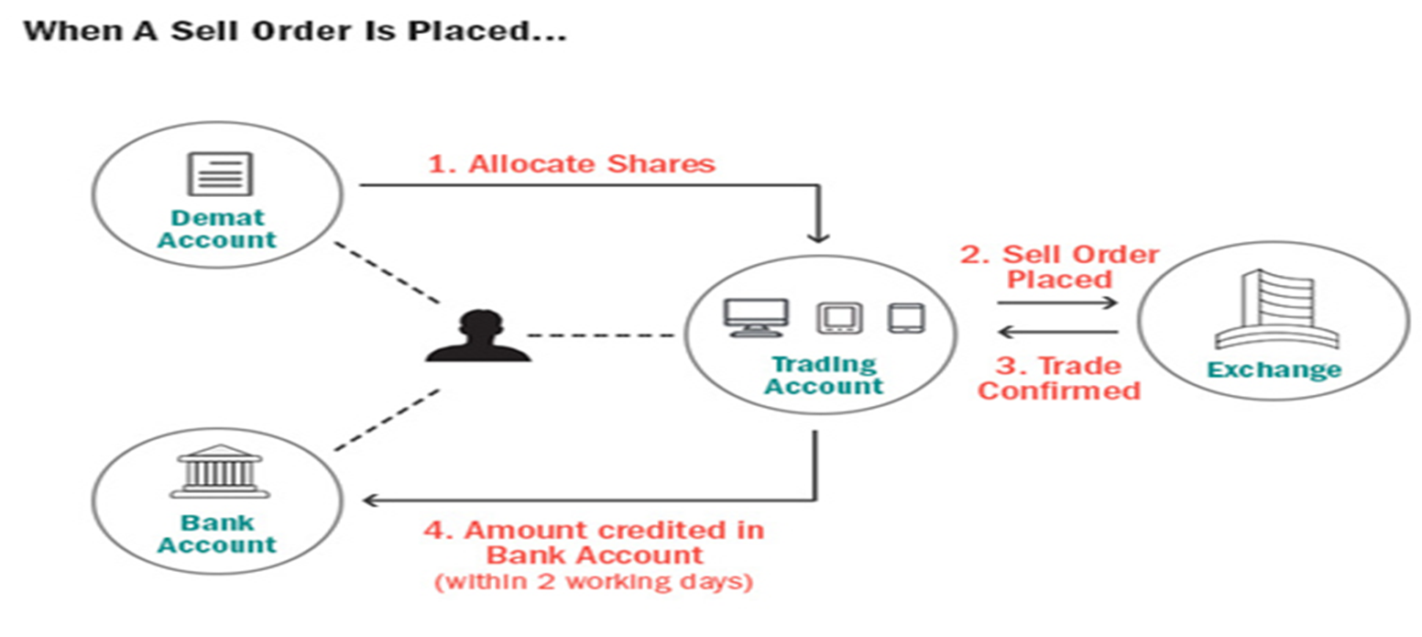
How to start online trading :

Slide 16

Process of online trading :

Slide 17
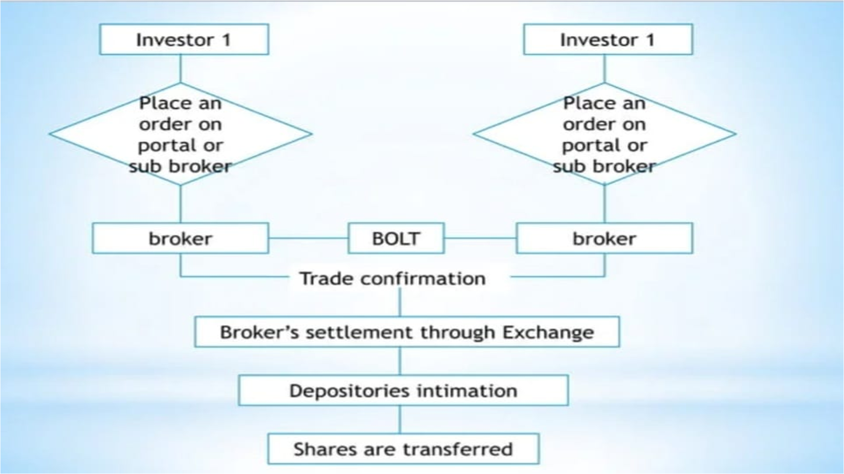

Slide 18
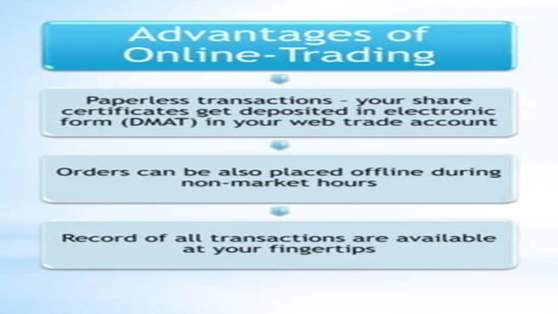

Slide 19
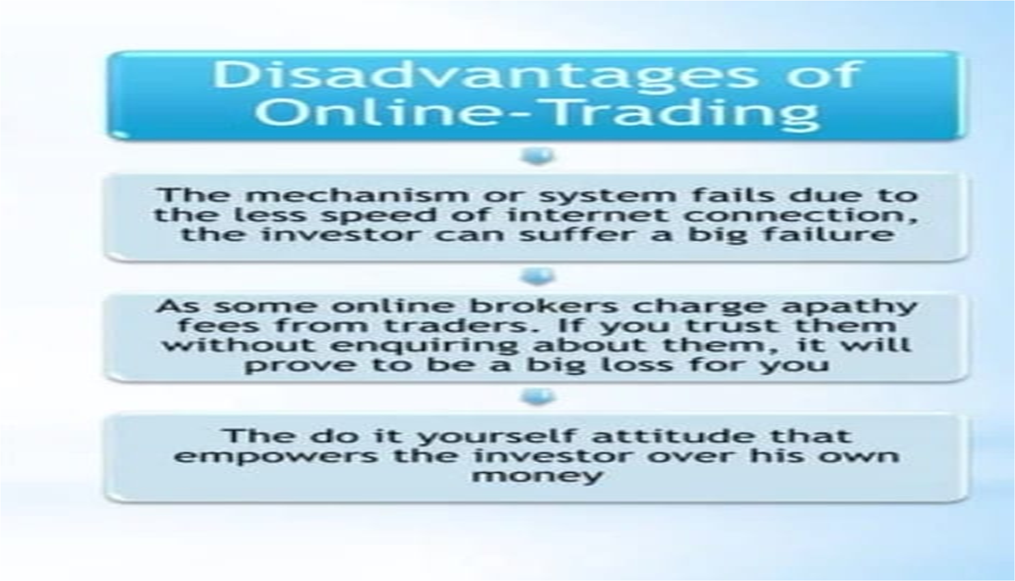

Slide 20
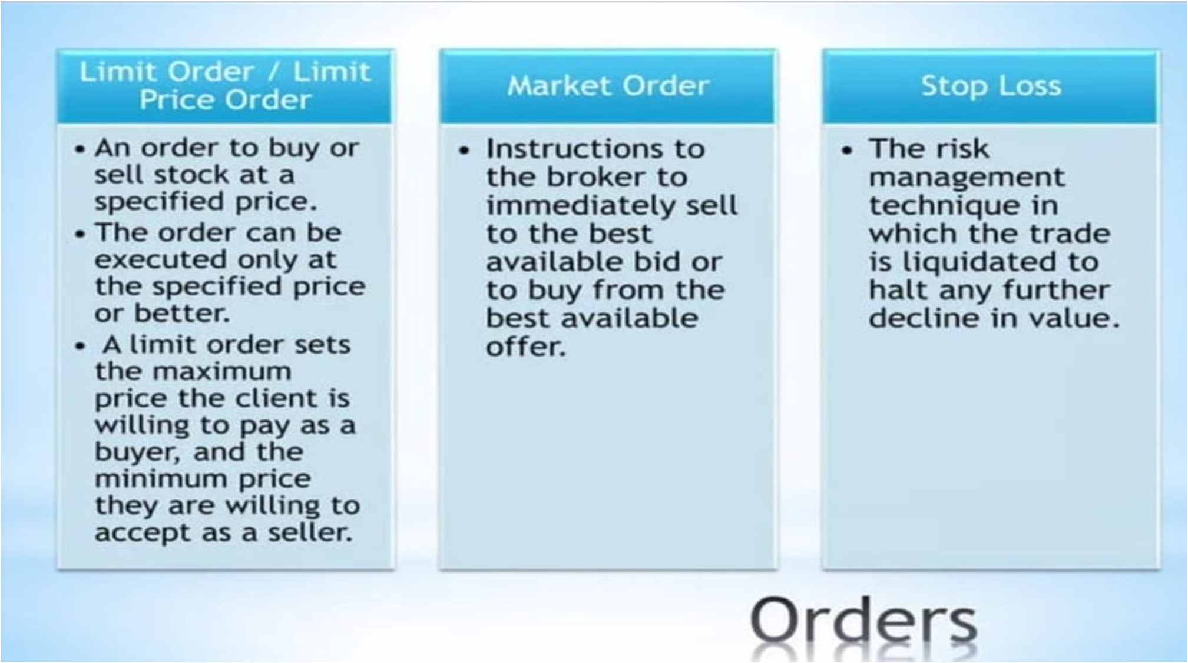

Slide 21
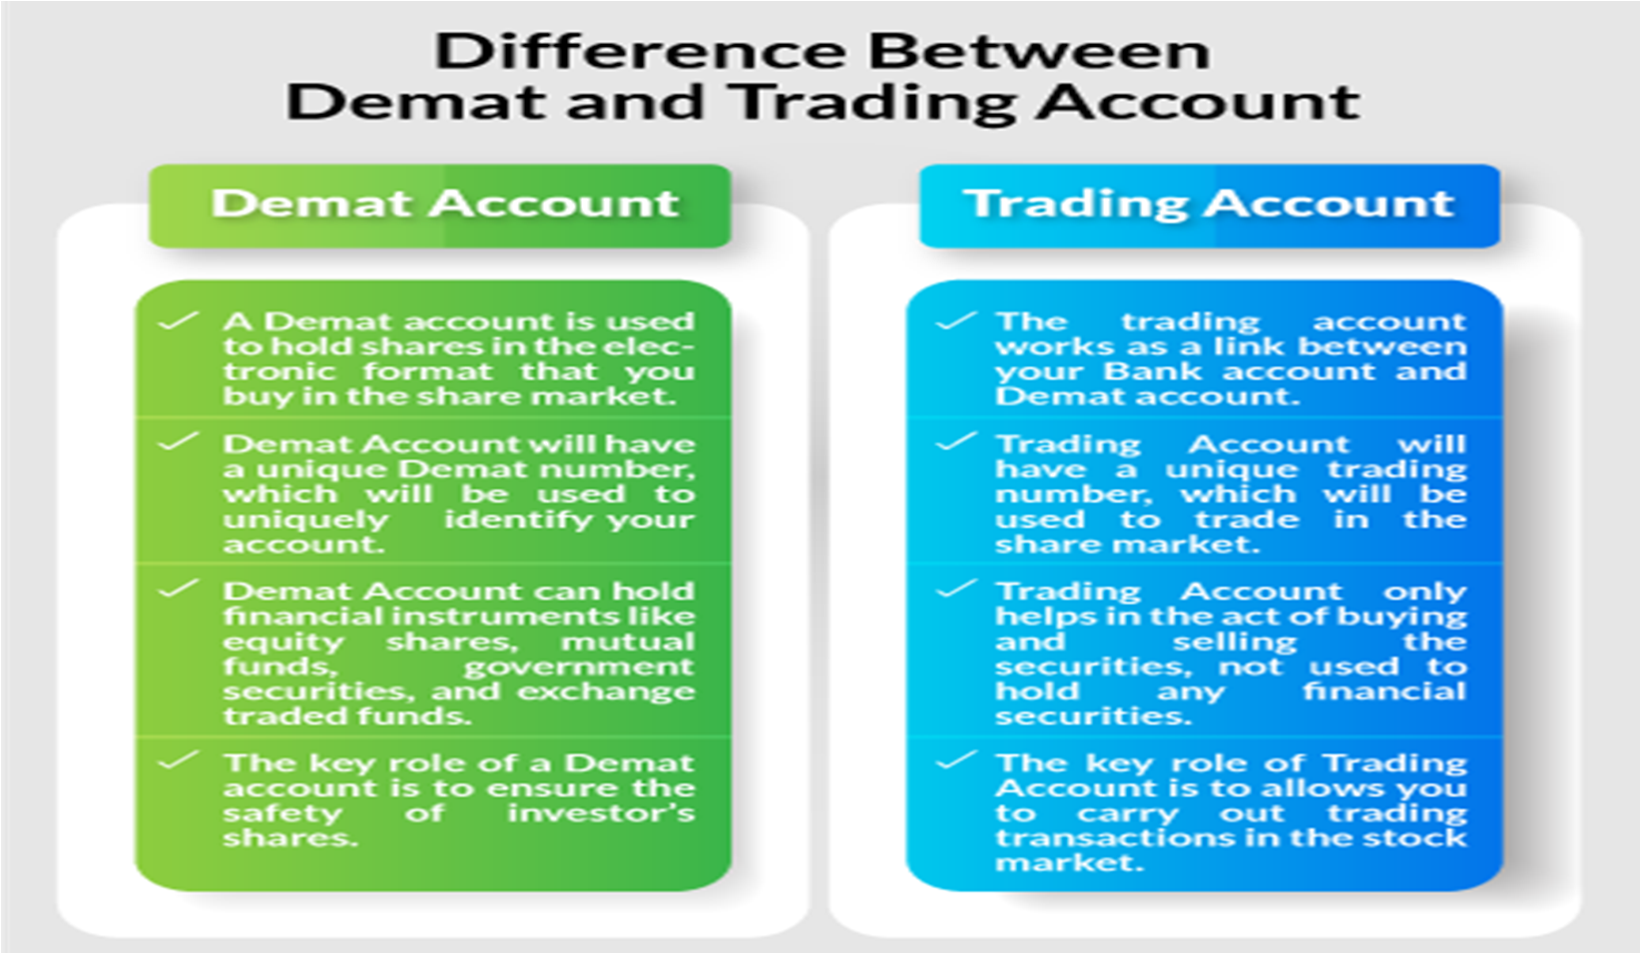

Slide 22





Top Forex Brokers in India :

Slide 23

How to do Online Trading:
Through https://startuptalky.com/top-demat-account-opening-platforms/#Groww

Slide 24


